Slide 1
ibl(instance based learning)
K-NN
Lazy learning
Non parametic learning

Slide 2
Pros and cons
strength
- use data "as is." Doesn't care about the format of the records.
- its ability to adapt. merely incorporating new data makes it possible for IBL to learn about new categories.
- simplicity of algorithm
- no training
cons
- store large amount of historical data
- classifying requires is time consuming
- difficulty of finding optimal distance function or combination function

Slide 3
memory-based reasoning(MBR)
과거에 현재의 문제와 유사한 문제가 존재하였고 그것이 어떻게 해결되었는지를 안다면, 과거의 경험을 바탕으로 현재 문제의 해결책을 추론 할 수 있다는 이론
-> 분류, 예측에 모두 사용가능
-> distance function
-> combination function(답에 도달하기 까지의 결과의 조합)
-> 지리적 위치, 이미지, 복잡한 문자열등과 같이 일반적으로 다른 분석기법으로 다루기 힘든 데이터 형태를 다룰 수 있음

Slide 4
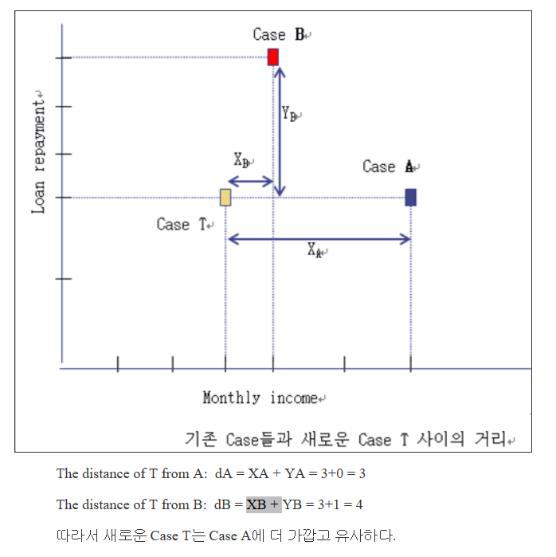
K-NN(nearest-neighbor)
현재의 문제와 유사한 과거사례를 찾기 위하여 사용

Slide 5
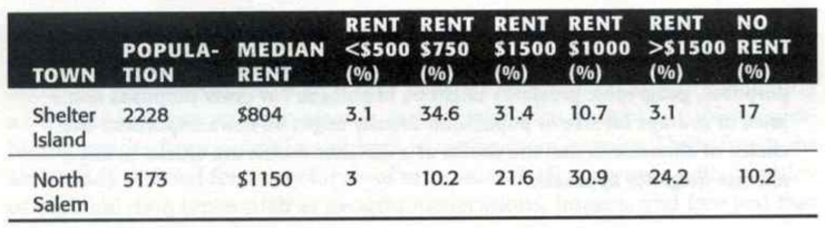
possible combination functions
Common rents
1000, 1500
2K-NN
Median rents
804,1150
average the most common rents of the two neighbors
(1000 + 1500)/2 = $1,250
the actual plurality rents in Tuxedo are $1,000 to $1,500 with the midpoint $1,250. - the median rent is $907
2) pick the point midway between the two median rents
(804 + 1150)/2 = $977

Slide 6
Three main issues in IBL
1) choosing an appropriate set of historical records
-> 각 카테고리당 몇 십개의 데이터 필요
2) choosing the most effective way to represent the training records
-> 반복 데이터를 줄여줘야함
3) choosing the distance function, combination function, and the number of neighbors

Slide 7
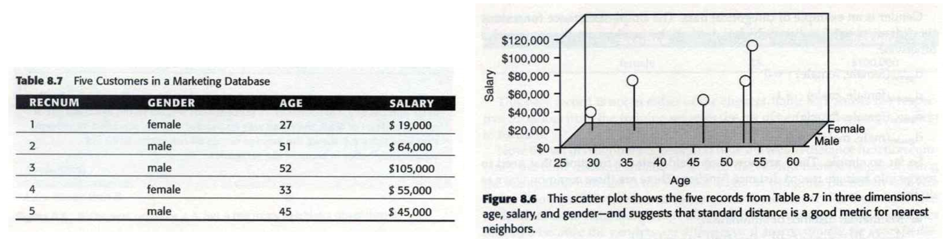
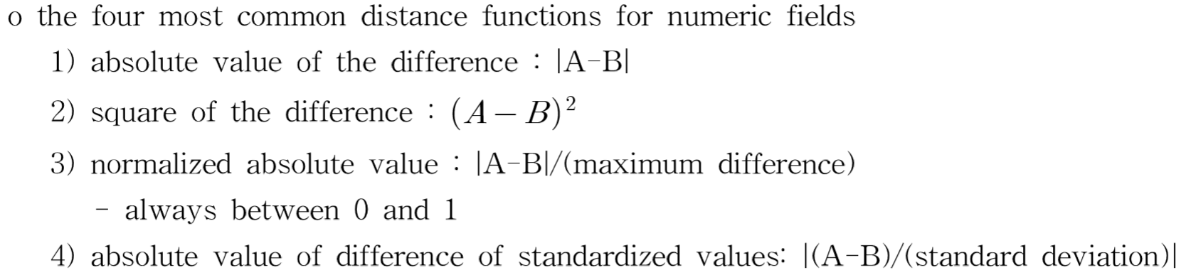
문제예상
분산: 편차 제곱의 합/개수
표준편차: root(분산)
Make nomalized absolute value graph

Slide 8
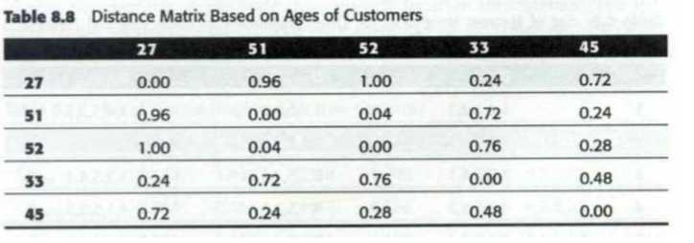

normalized absolute value graph of Age
Most far $d_{age}$

Slide 9
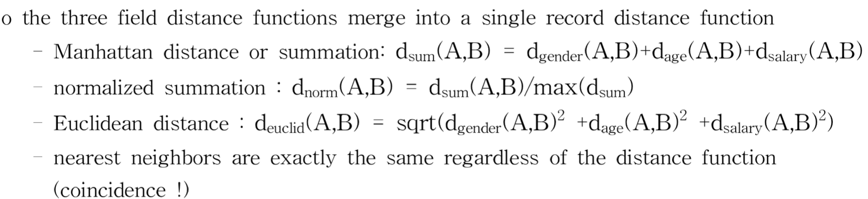
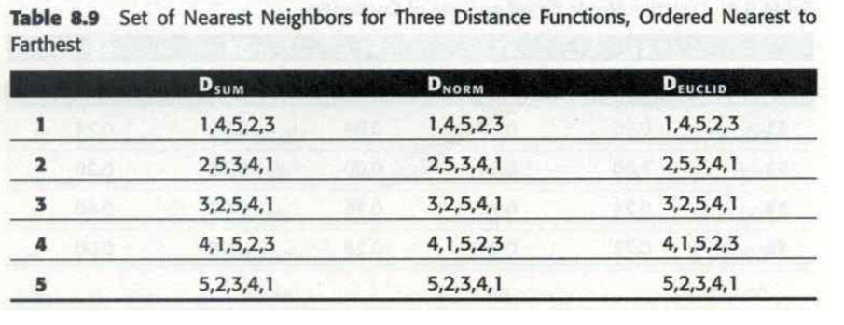
1) Building a Distance Function One Field at a Time
가까운순 으로
인덱스 나열
Training
set

Slide 10
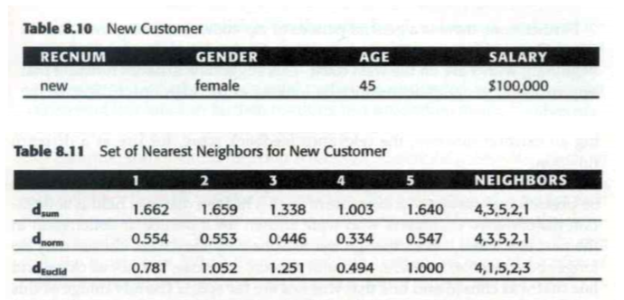
1) Building a Distance Function One Field at a Time
Test set

Slide 11
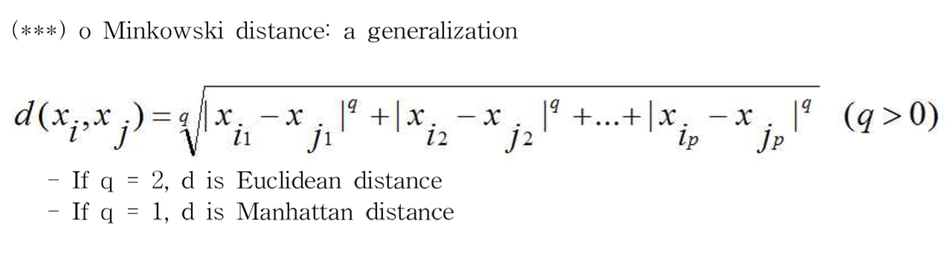
2) using square of the difference & Manhattan distance

Slide 12
The Basic Approach
k nearest neighbor vote on the answer--"democracy" in data mining
- when the task is to assign a single class, it is simply the one with the most votes. (근접한 이웃 갯수가 투표 수)
K should be odd to avoid tie-break
K가 홀수 여야지 결정을 할 수 있음 (같은 투표수 피함)
use
Use c+1 neighbors when there are c categories to ensure that at least one class has a plurity (적어도 하나의 클래스가 여러수 (복수) 를 가지도록 함)

